Slide 1

OPTIMIZATION FOR SOLAR POWER GENERATION
IST 707: Project Proposal
Presented by: Sai Krishna Bolla, Samar Zemeer
Mohammed Huzaif Kherani, Shabib Khan

Slide 2
Business Problem
The Intergovernmental Panel on Climate Change (IPCC) has found that emissions from fossil fuels are the dominant cause of global warming. In 2018, 89% of global CO2 emissions came from fossil fuels and industry
01
Coal is a fossil fuel, and is the dirtiest of them all, responsible for over 0.3C of the 1C increase in global average temperatures. This makes it the single largest source of global temperature rise.
02
Oil releases a huge amount of carbon when burned - approximately a third of the world’s total carbon emissions. There have also been several oil spills in recent years that have a devastating impact
03

Slide 3
Project Overview
The world is now realizing how harmful fossil fuels are for the environment, though a little late in the game. People are turning to renewable energy as the end of the world draws closer in an effort to prevent it. The sun is a reliable source of clean energy, which is fortunate. We will be working with a dataset to optimize solar power production using ML models.
A solar power generation company wants to optimize solar power production and needs the prediction model to predict ‘Clearsky DHI’, ‘Clearsky DNI’, ‘Clearsky GHI’.

Slide 4
Dataset Overview
This data collected in an interval of every 30 mins for ten years.
It consists of 18 variables.
'Year', 'Month', 'Day', 'Hour', 'Minute', 'Temperature', 'Clearsky DHI', 'Clearsky DNI', 'Clearsky GHI', 'Cloud Type', 'Dew Point', 'Fill Flag', 'Relative Humidity', 'Solar Zenith Angle', 'Pressure', 'Precipitable Water', 'Wind Direction', 'Wind Speed’.
Out of which we need to analyze 3 variables, 'Clearsky DHI', 'Clearsky DNI', 'Clearsky GHI’.

Slide 5
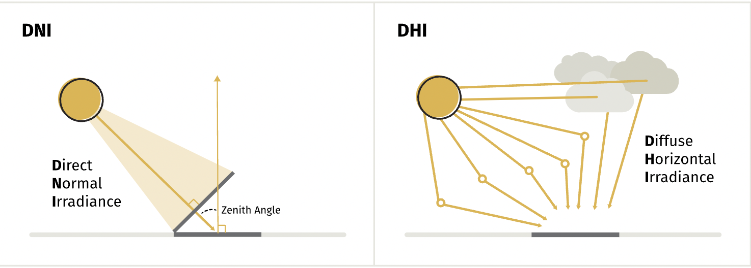
Clearsky DHI - Diffuse horizontal irradiance is the portion of solar radiation that reaches the earth indirectly. Water vapor, aerosols and clouds reflect and absorb solar radiation, diffusing it throughout the atmosphere. Clearsky DNI - Direct normal irradiance (DNI) is the portion of solar radiation that reaches the earth on a direct path from the sun. Clearsky GHI - Global horizontal irradiance is nothing but the sum of DHI and DNI*Zenith Angle.

Slide 6
Proposed Approach
K -means Clustering.
Decision Tree
Classification (10 folds cross validation)
Regression (Logistic regression/ Multiple regression)

Slide 7
Task Allocation
 | Sai | Shabib | Samar | Huzaif
1. Data Cleaning & Preprocessing |  | ✓ | ✓ | ✓
2. Descriptive Statistics | ✓ |  | ✓
3. Machine Learning Techniques (Clustering & Classification) |  | ✓ |  | ✓
4. Machine Learning Techniques (Regression) | ✓ | ✓ |  | ✓
5. Final Report | ✓ |  | ✓
6. Final Presentation | ✓ | ✓ | ✓ | ✓

Slide 8
Thank you,
Professor.
Presented by
Sai Krishna Bolla
Samar Zemeer
Mohammed Huzaif Kherani
Shabib Khan

